Slide 1


Software Quality Assurance
Test Case Documentation
Presented by
Shumail Zahra

Slide 2
Welcome!!

Slide 3
Content
Test Scenario
How to identify test scenarios
Test Cases
How to write test cases
Importance of test cases

Slide 4
Test scenario

Slide 5
What is a Test Scenario?
A Test Scenario is defined as any functionality that can be tested. It is a collective set of test cases which helps the testing team to determine the positive and negative characteristics of the project.
Test Scenario gives a high-level idea of what we need to test.

Slide 6
Example
For an eCommerce Application, a few test scenarios would be
Test Scenario 1: Check the Search Functionality
Test Scenario 2: Check the Payments Functionality
Test Scenario 3: Check the Login Functionality

Slide 7
Test cases

Slide 8
Test case writing is a major activity and considered as one of the most important parts of software testing. It is used by the testing team, development team as well as the management.
A typical definition for test case is a ‘set of conditions under which a tester will determine whether an application or software system or one of its features is working as expected.’

Slide 9
What is a Test Case?
A TEST CASE is a set of actions executed to verify a particular feature or functionality of your software application.
A Test Case contains test steps, test data, precondition, post condition developed for specific test scenario to verify any requirement.

Slide 10
The test case includes specific variables or conditions, using which a testing engineer can compare expected and actual results to determine whether a software product is functioning as per the requirements of the customer.

Slide 11
Example
Check system behavior when valid email id and password is entered.
Check system behavior when invalid email id and valid password is entered.
Check system behavior when valid email id and invalid password is entered.
Check system behavior when invalid email id and invalid password is entered.
Check system behavior when email id and password are left blank and Sign in entered.

Slide 12
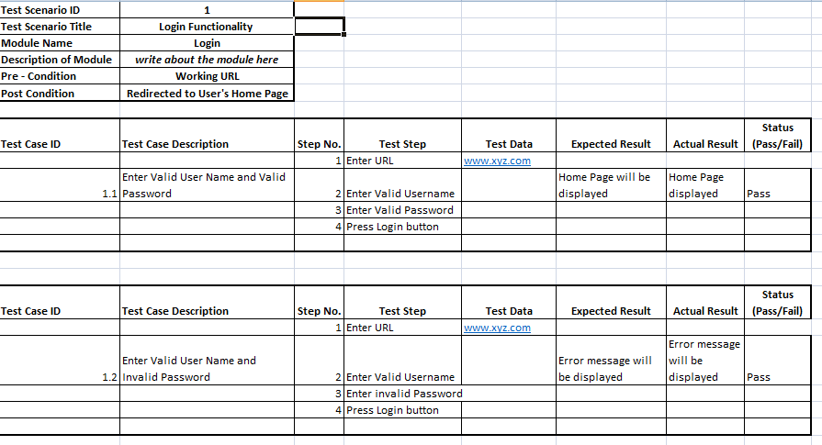
Test Scenario
Test Case

Slide 13
Importance of test cases
Test cases clarify what needs to be done to test a system. It gives us the steps which we execute in a system, the input data values which we enter in the system along with the expected results when we execute a particular test case.

Slide 14
Test cases bring together the whole testing process. If the test cases are ready, they are really helpful to measure weather client expectations were fulfilled or not. When we execute test cases, we can get more defects which may be skipped in ad-hoc testing.

Slide 15
Review Questions
What do you understand by Test Scenarios?
Are functionalities included in test cases or test scenarios?
Why is documenting test important?
How many test cases can be there in a test scenario?

Slide 16
Online Resources
https://www.youtube.com/watch?v=BBmA5Qp6Ghk&t=5s
https://www.youtube.com/watch?v=wMN0pCyjQ9E&list=PLDC2A0C8D2EC934C7&index=12&t=0s

Slide 17
Thank you

